Slide 1
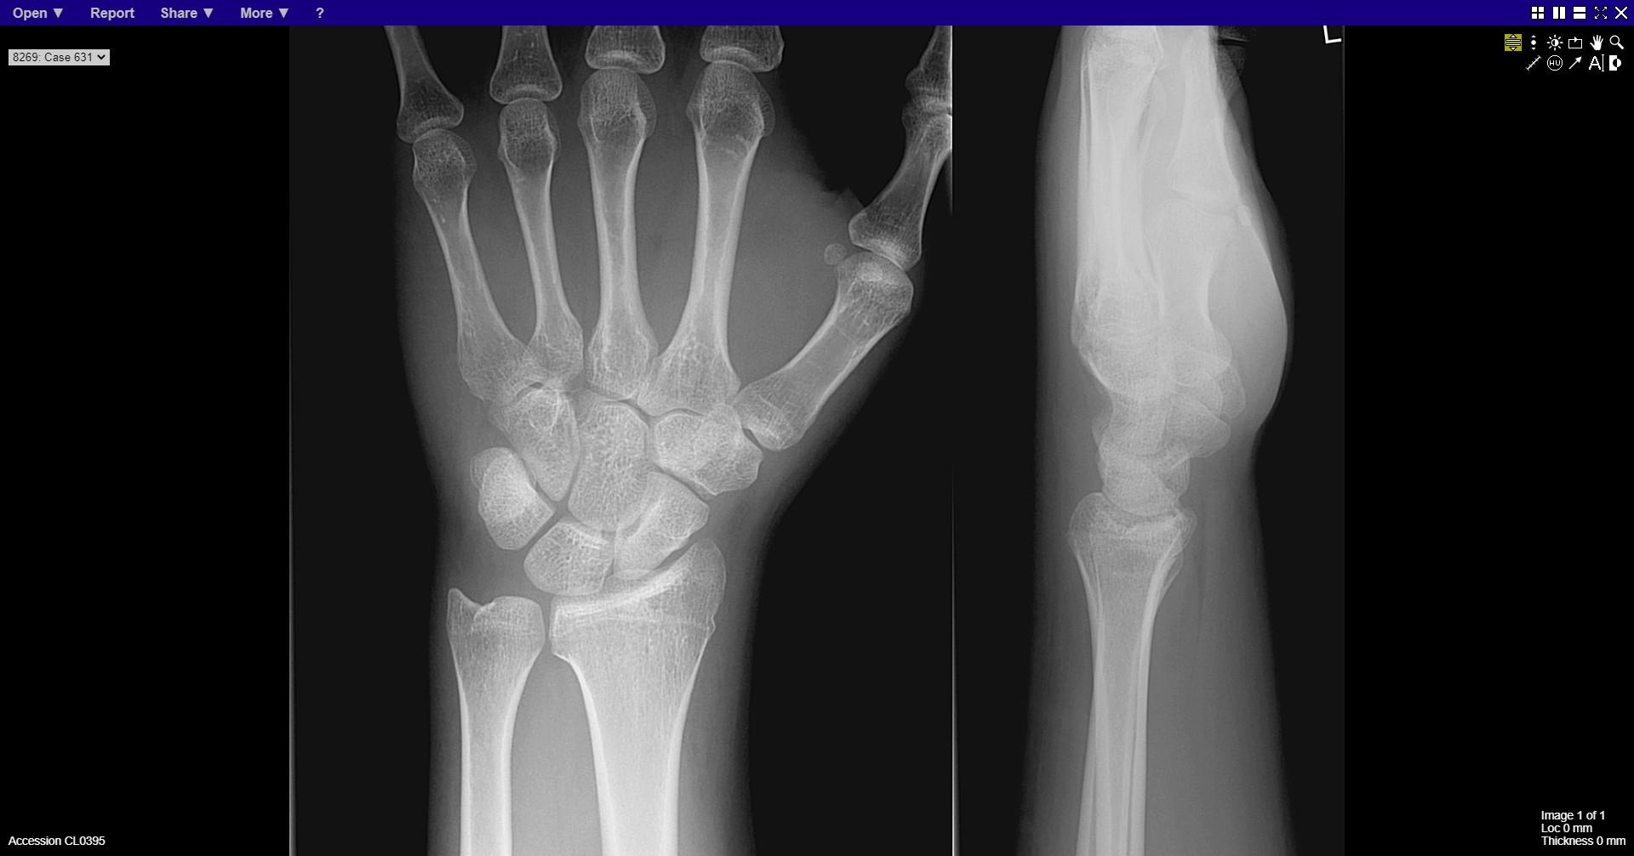
Notes:
Fracture distal radius

Slide 2
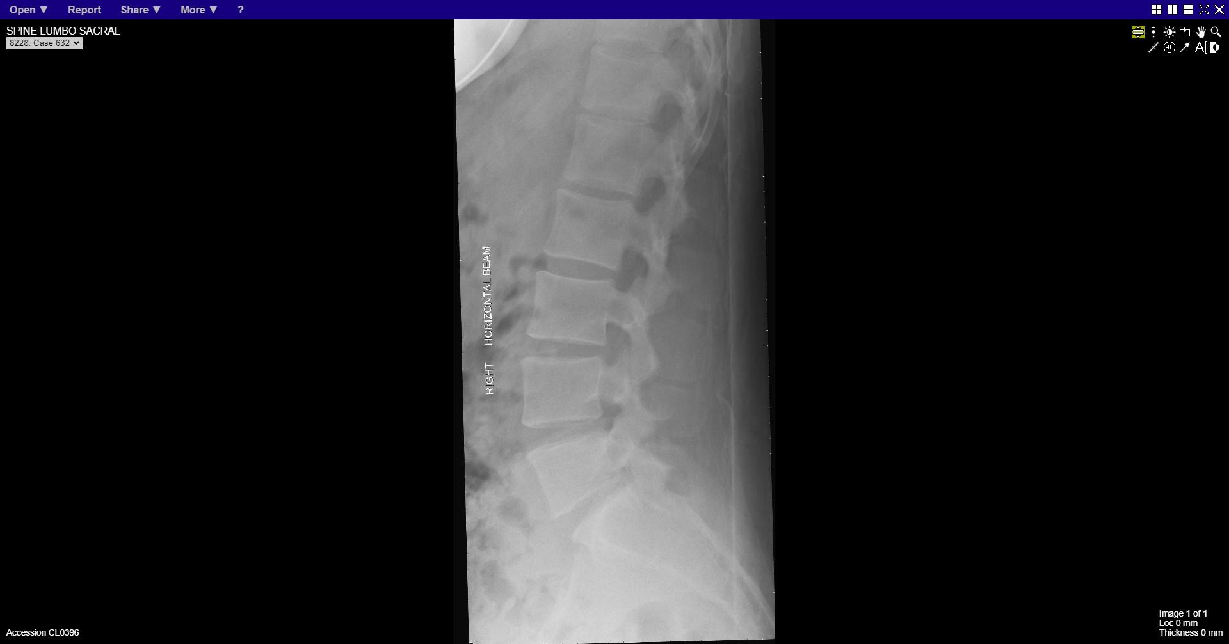
Notes:
normal

Slide 3
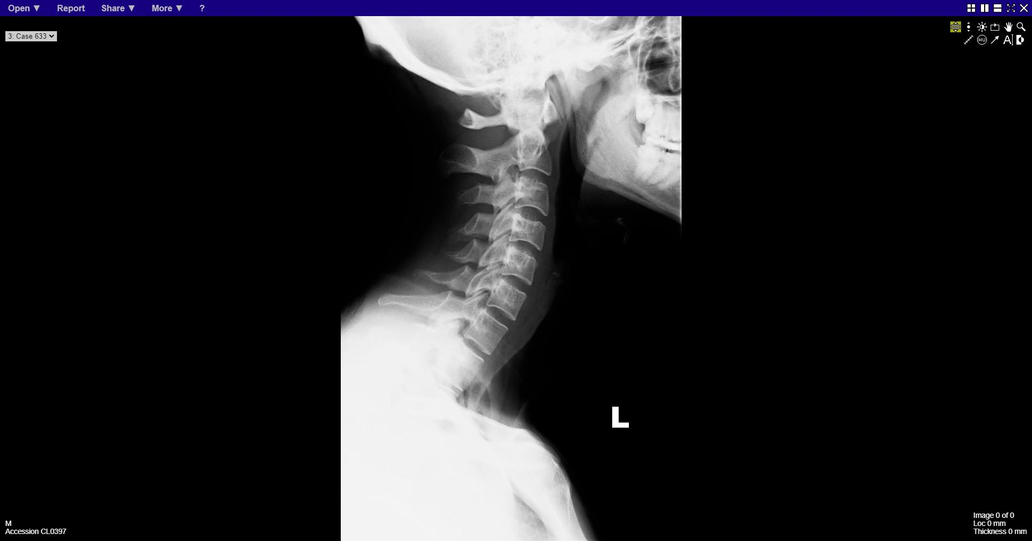
Notes:
normal

Slide 4
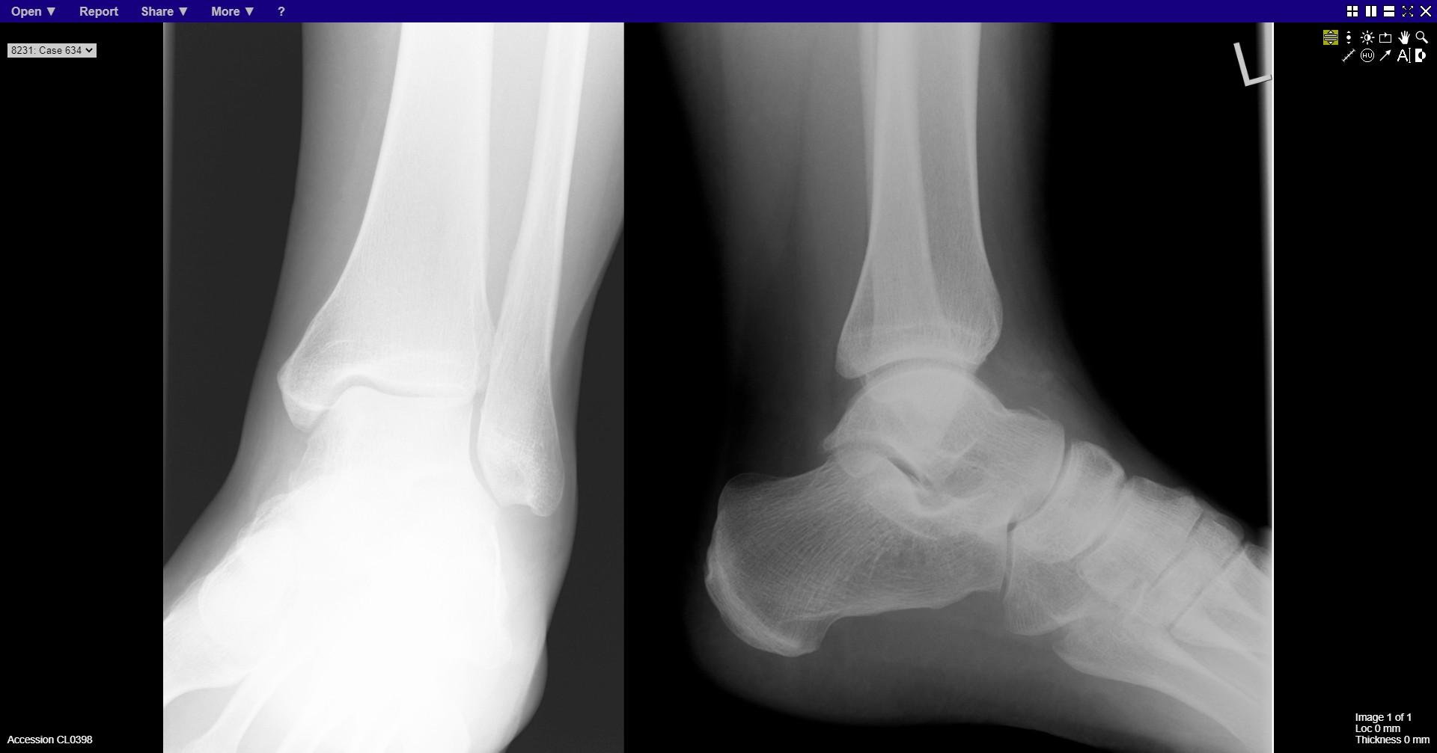
Notes:
Fracture dorsal talus

Slide 5
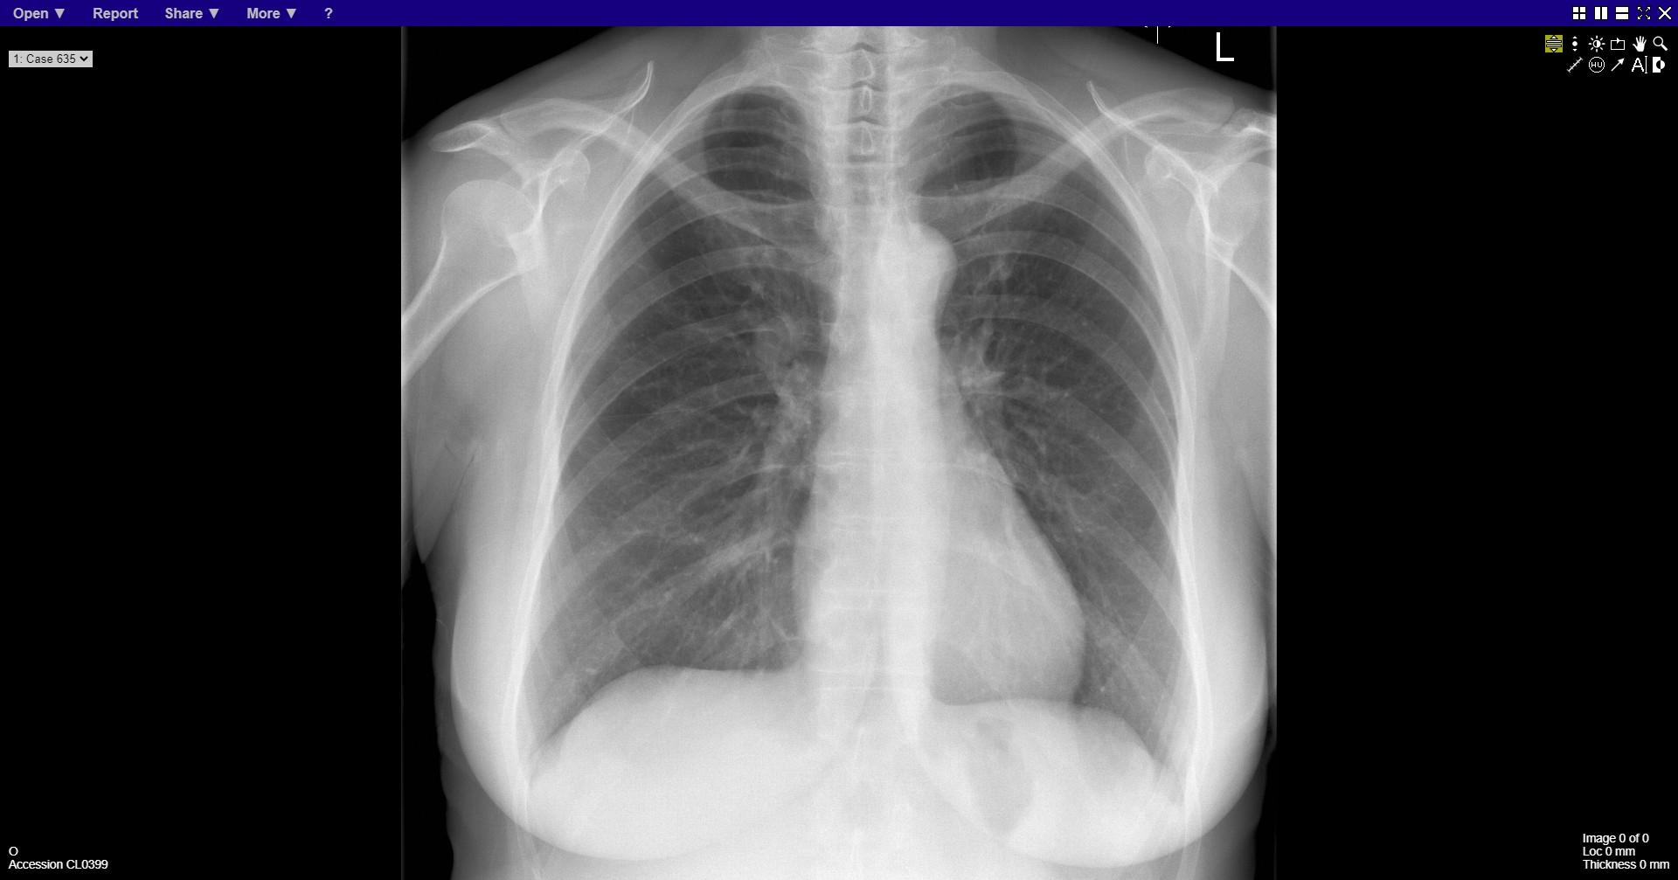
Notes:
Bronchial carcinoma – superior to right hilum
Right cervical rib

Slide 6
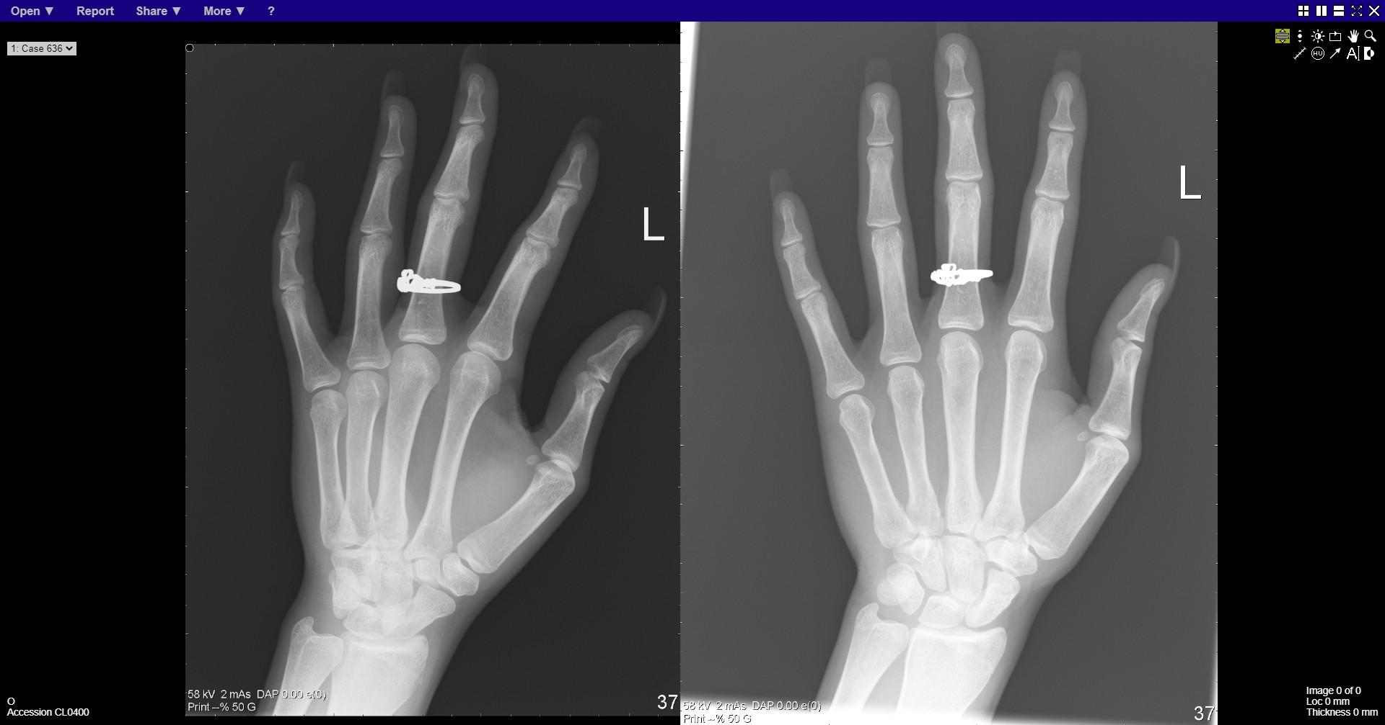
Notes:
normal

Slide 7
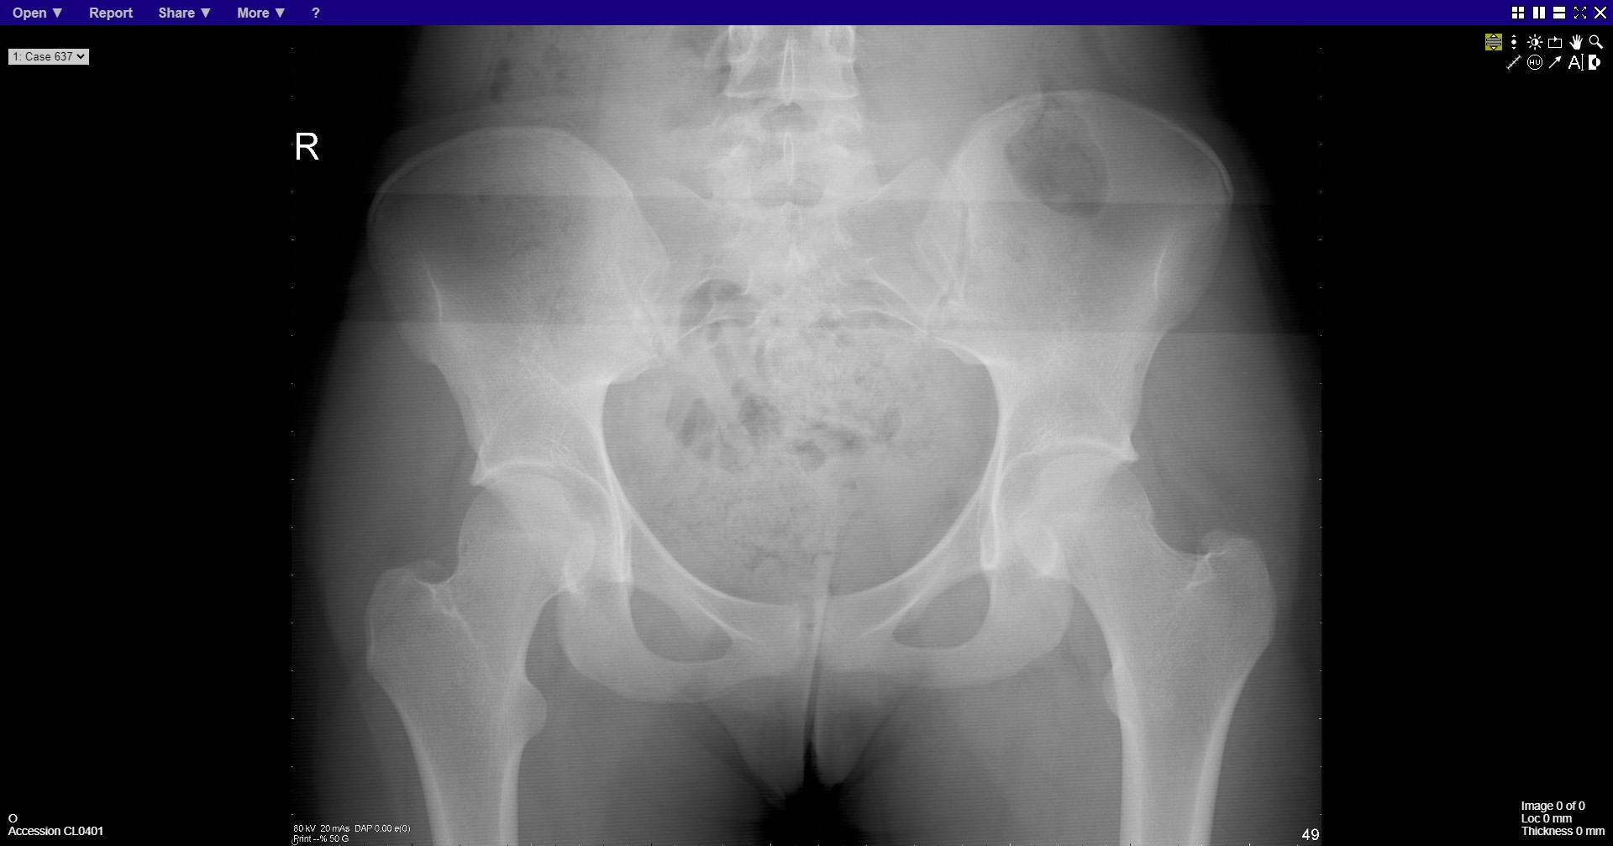
Notes:
normal

Slide 8
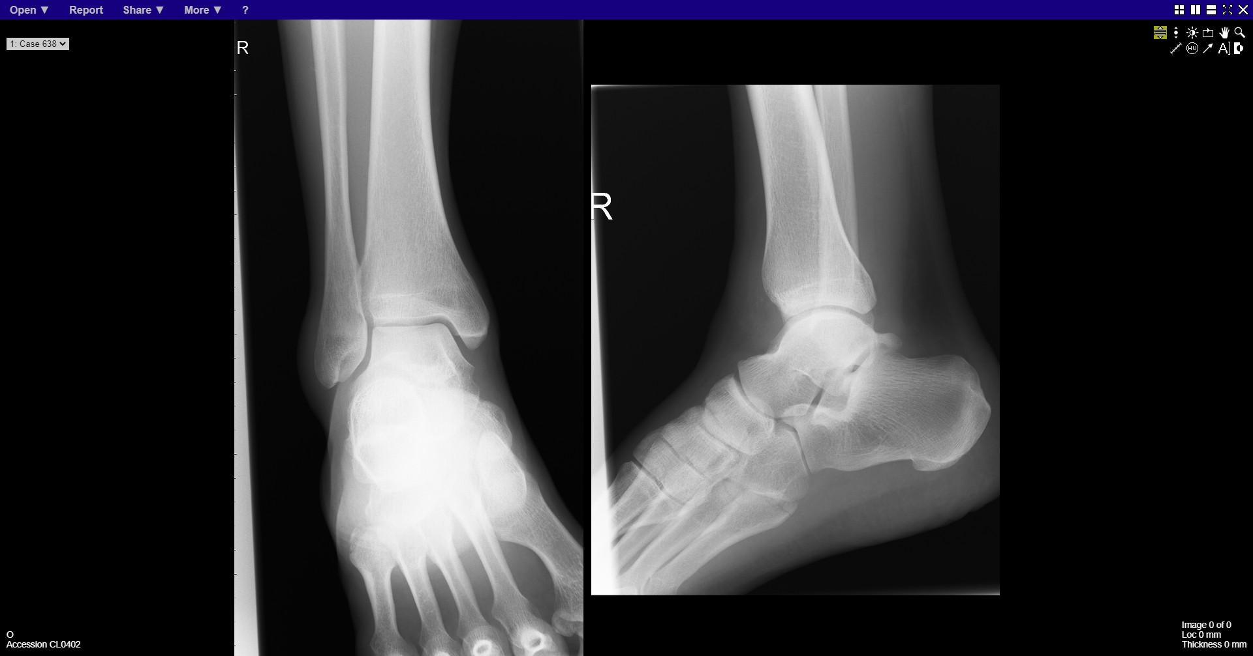
Notes:
Base of 5th fracture

Slide 9
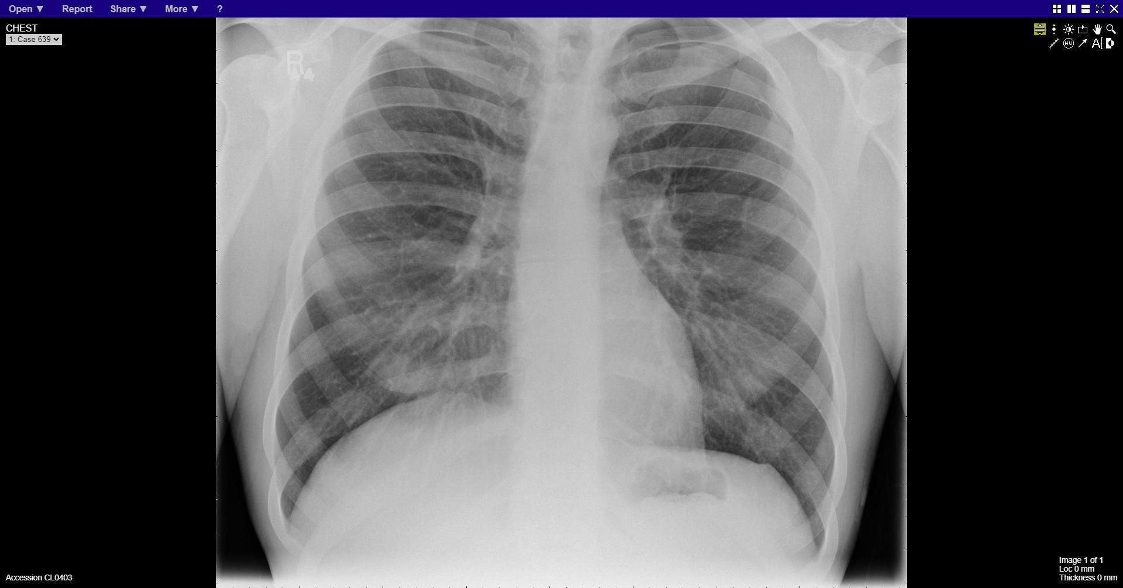
Notes:
Left apical pneumothorax

Slide 10
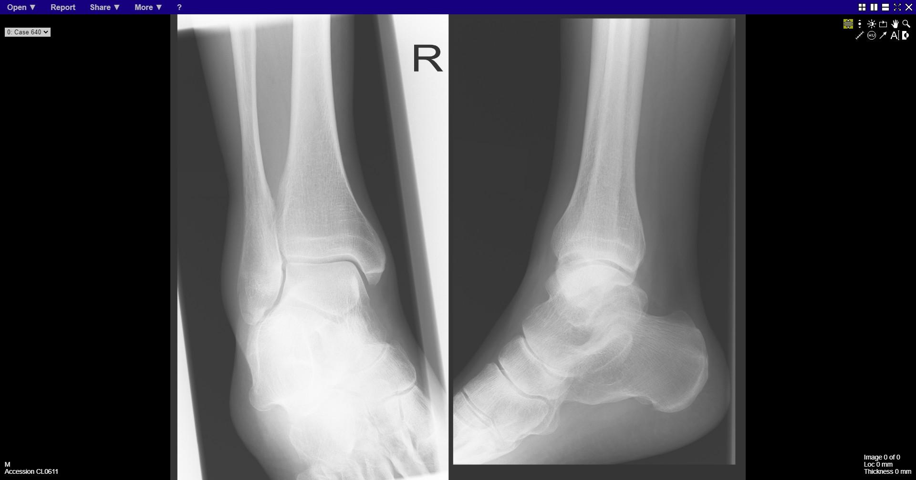
Notes:
Fracture distal fibiula

Slide 11
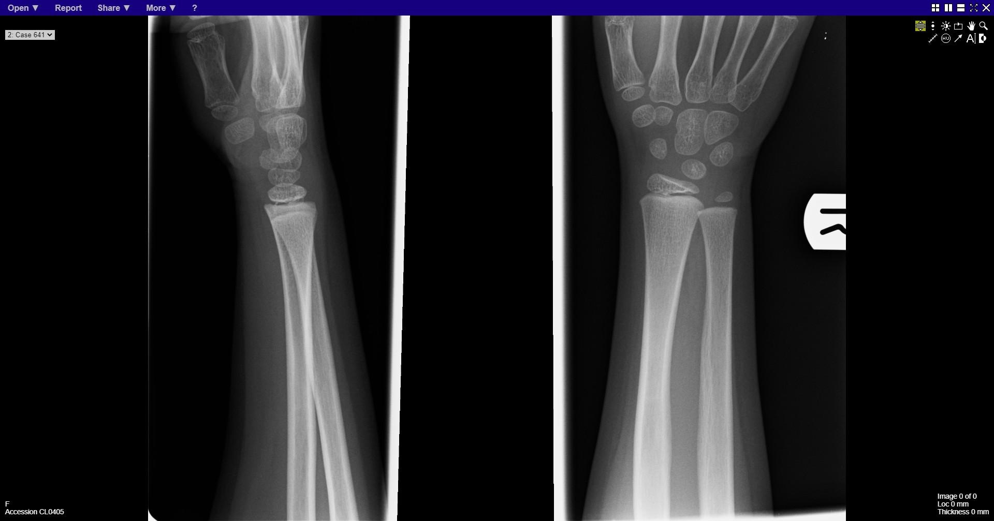
Notes:
normal

Slide 12
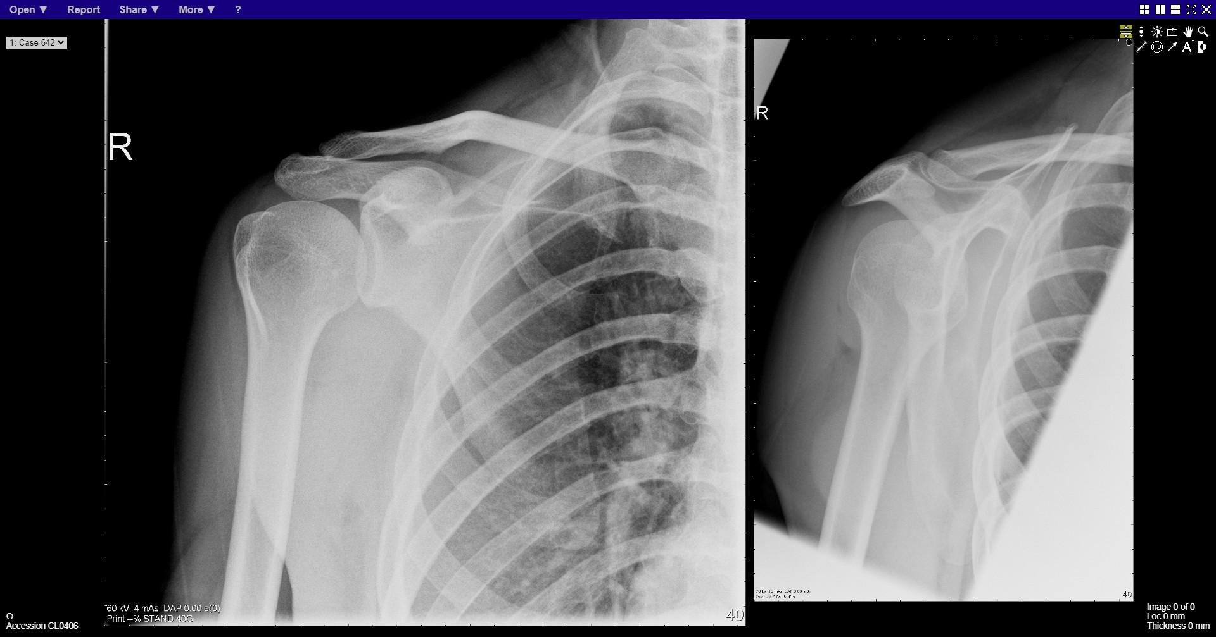
Notes:
Subluxation acromioclavicular joint

Slide 13
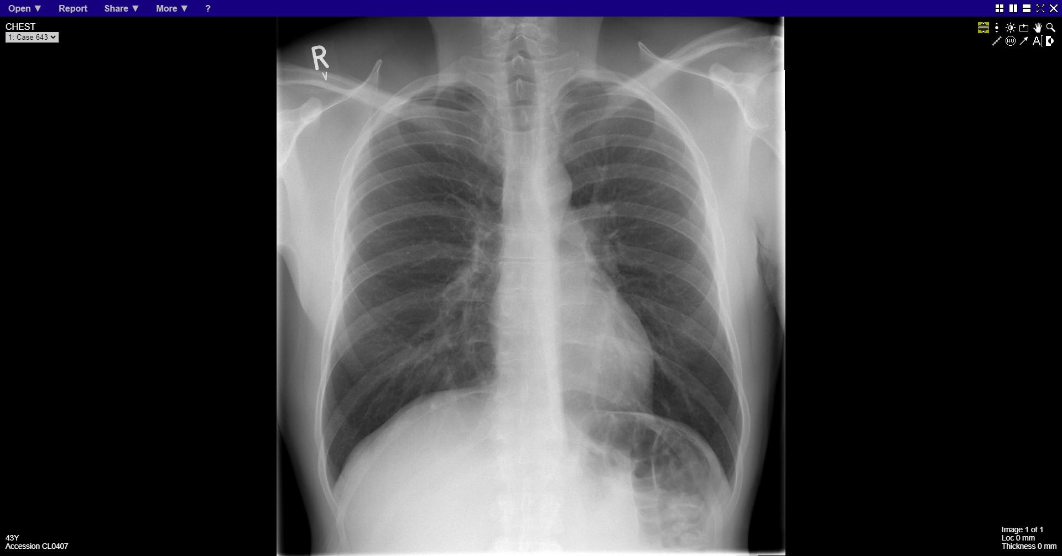
Notes:
normal

Slide 14
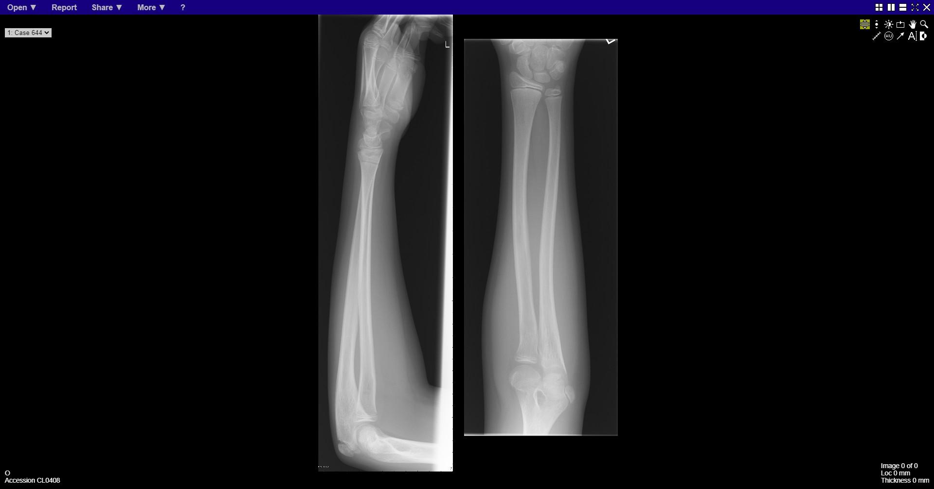
Notes:
Buckle fracture distal radius

Slide 15
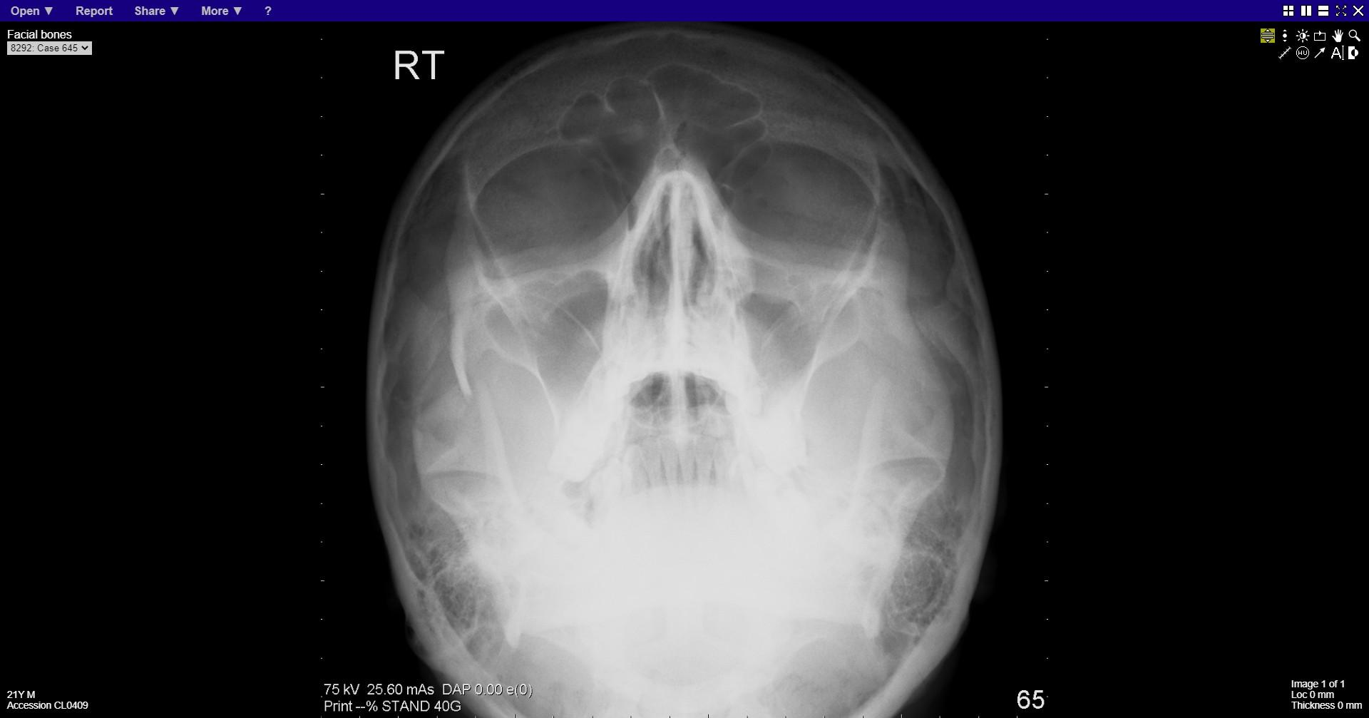
Notes:
Fracture right zygomatic arch

Slide 16
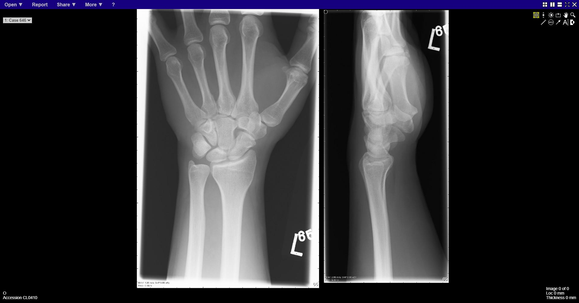
Notes:
normal

Slide 17
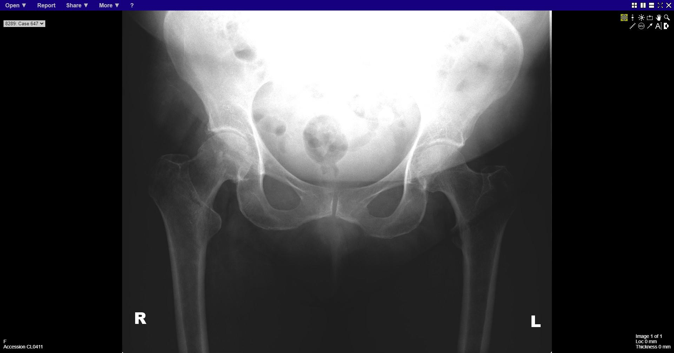
Notes:
Intertrochanteric fracture right hip

Slide 18
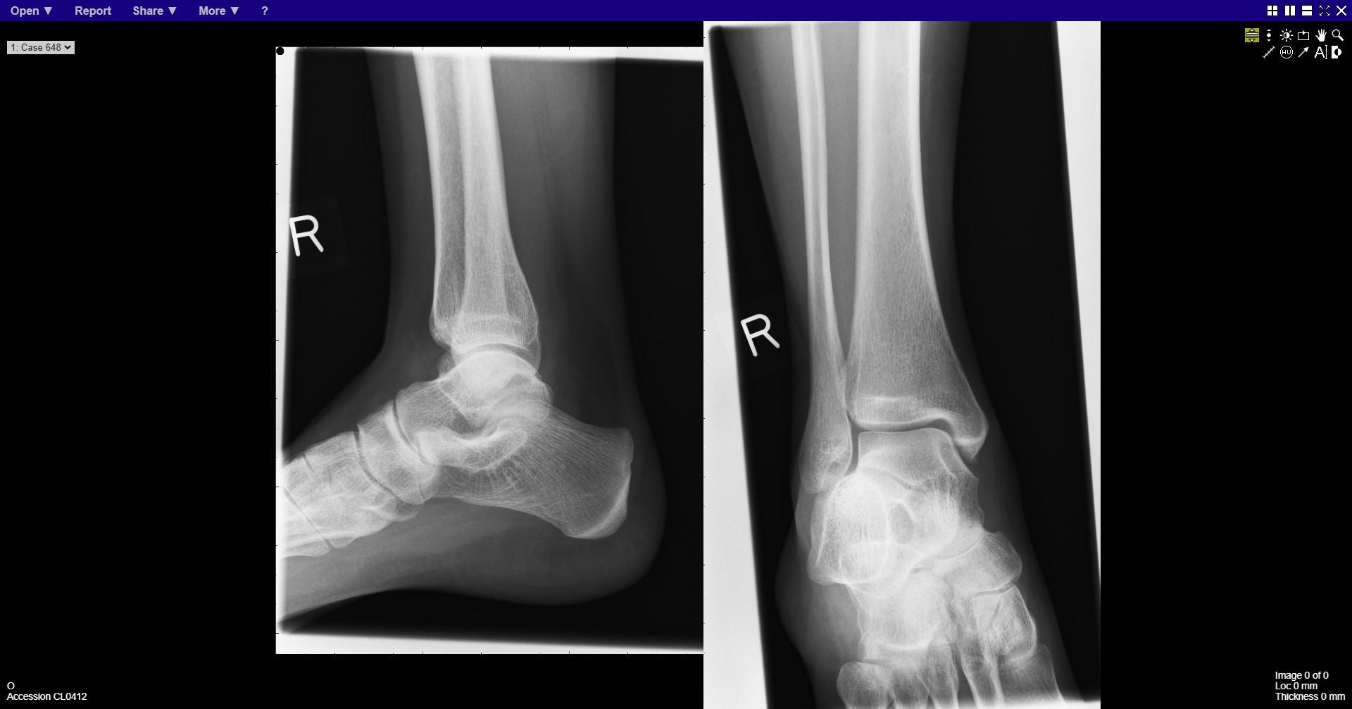
Notes:
normal

Slide 19
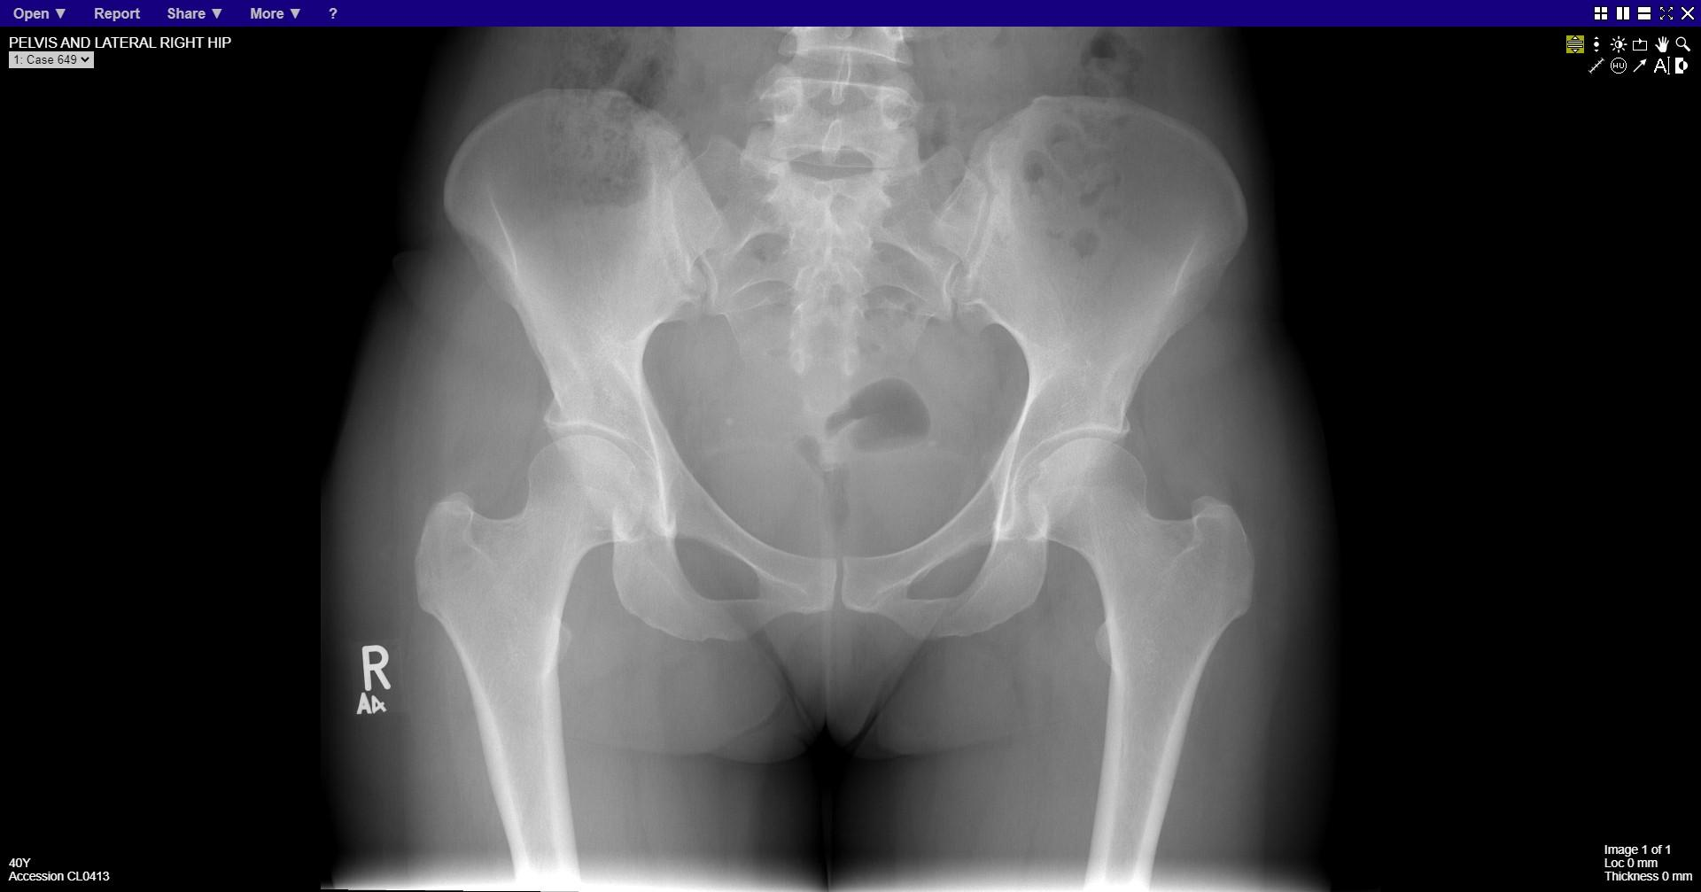
Notes:
normal

Slide 20
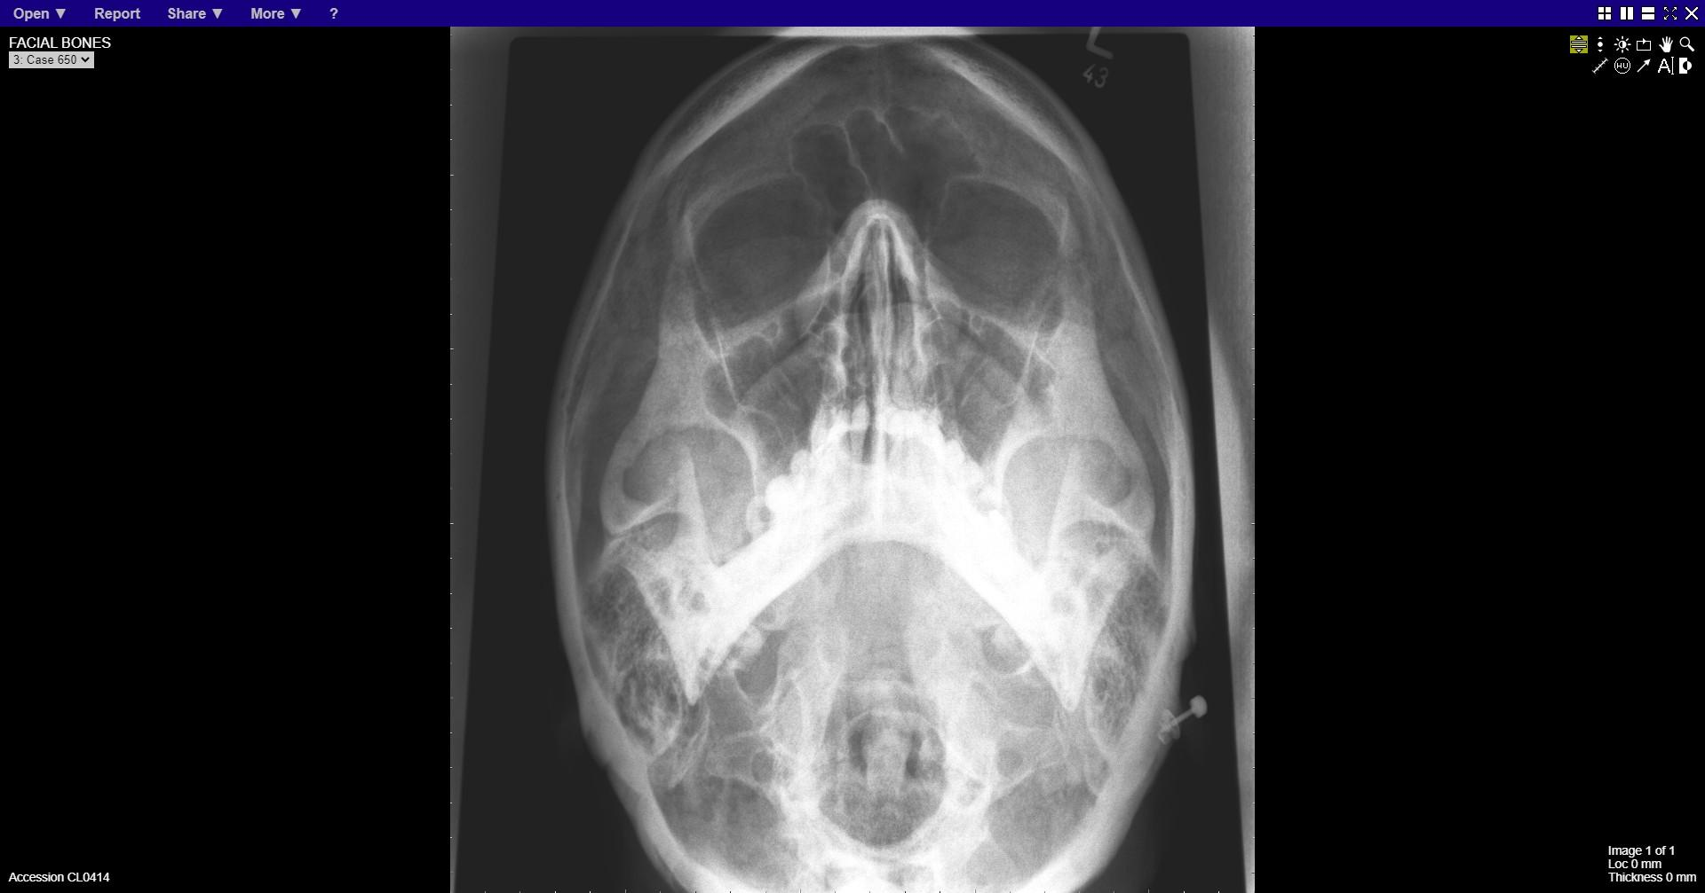
Notes:
normal

Slide 21
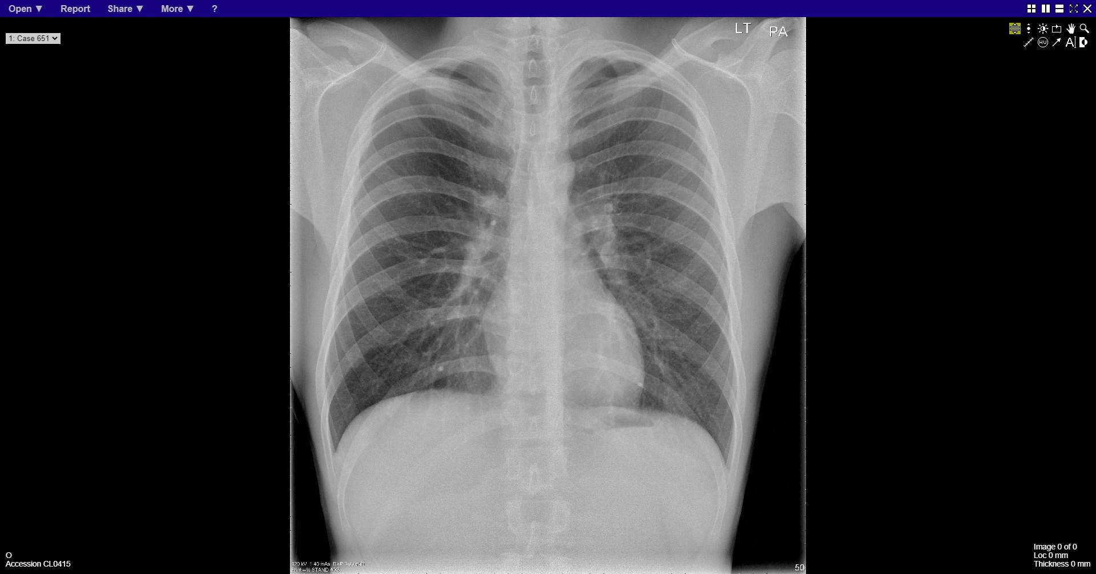
Notes:
normal

Slide 22
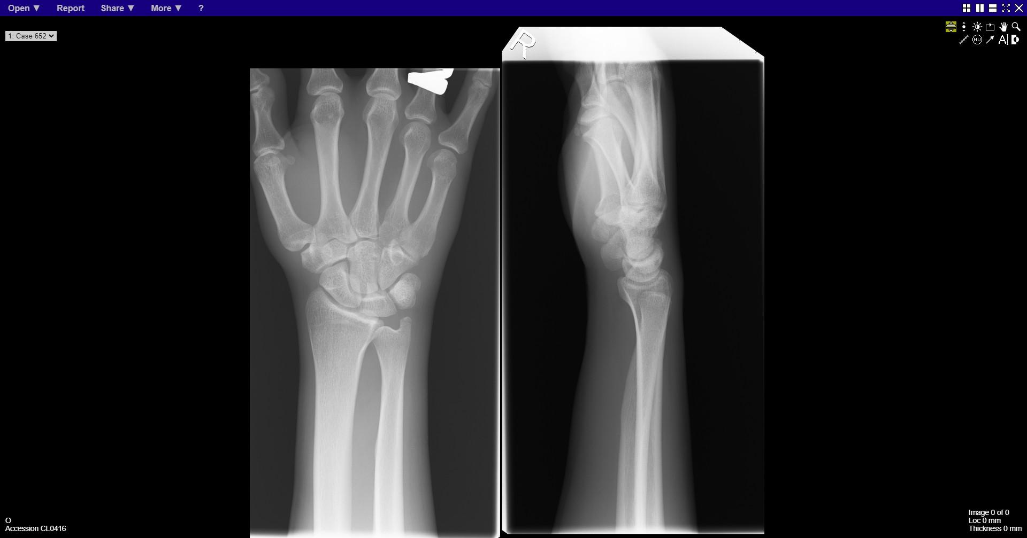
Notes:
normal

Slide 23
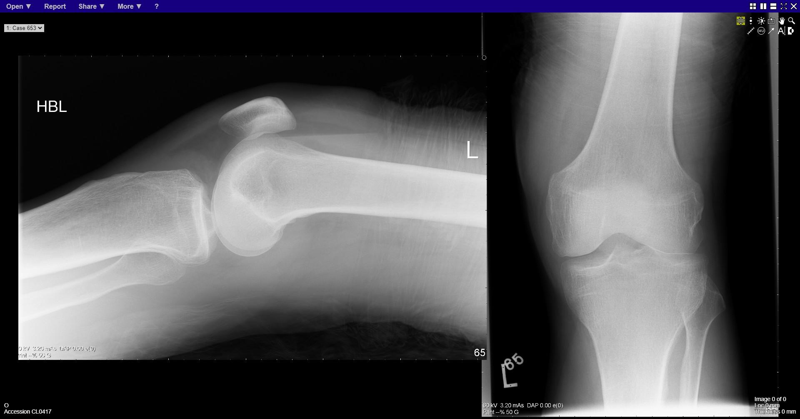
Notes:
Lipohaemarthrosis

Slide 24
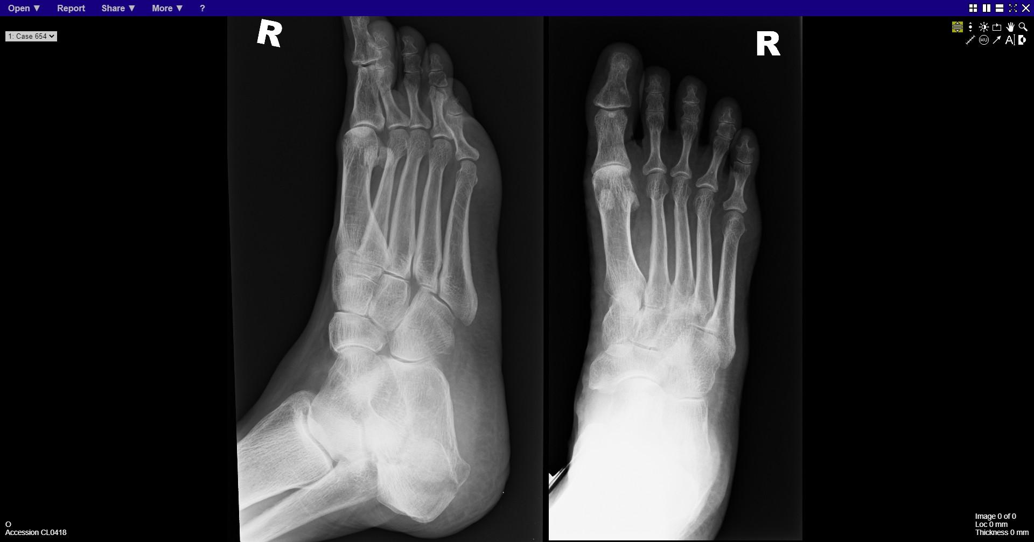
Notes:
Fracture calcaneum

Slide 25
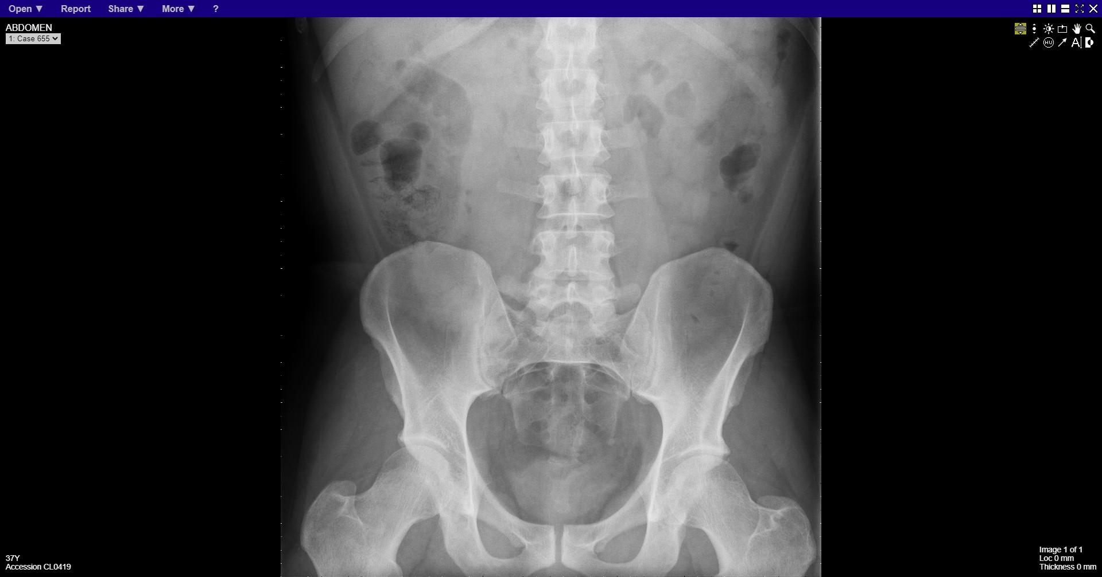
Notes:
normal

Slide 26
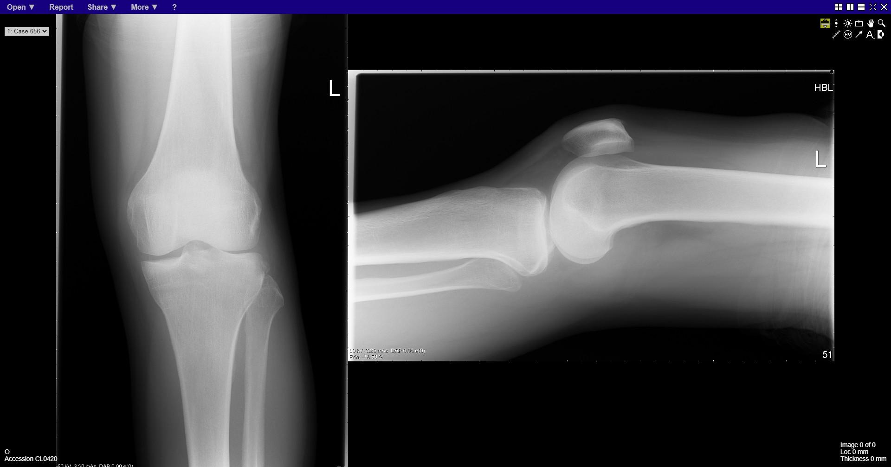
Notes:
Segond fracture

Slide 27
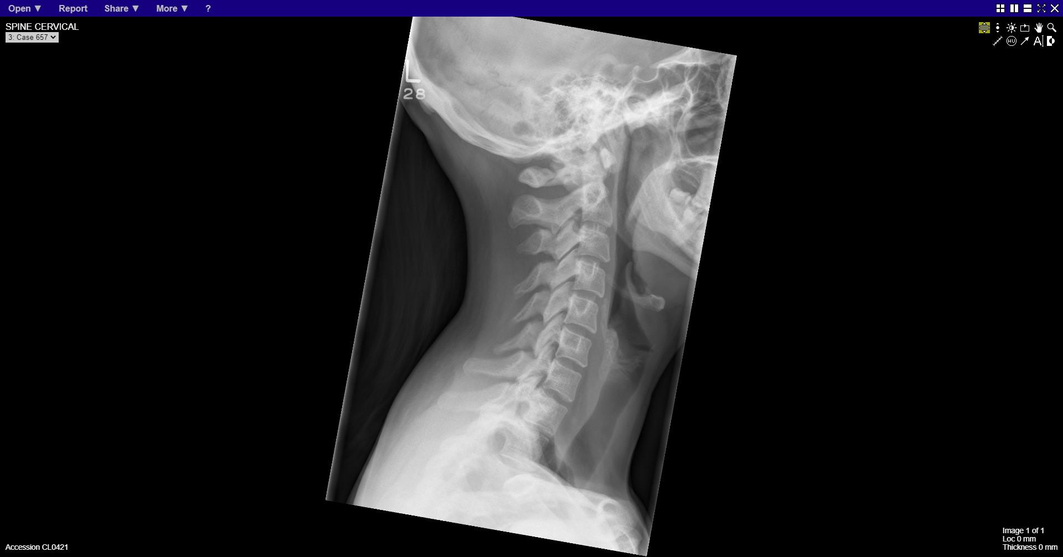
Notes:
normal

Slide 28
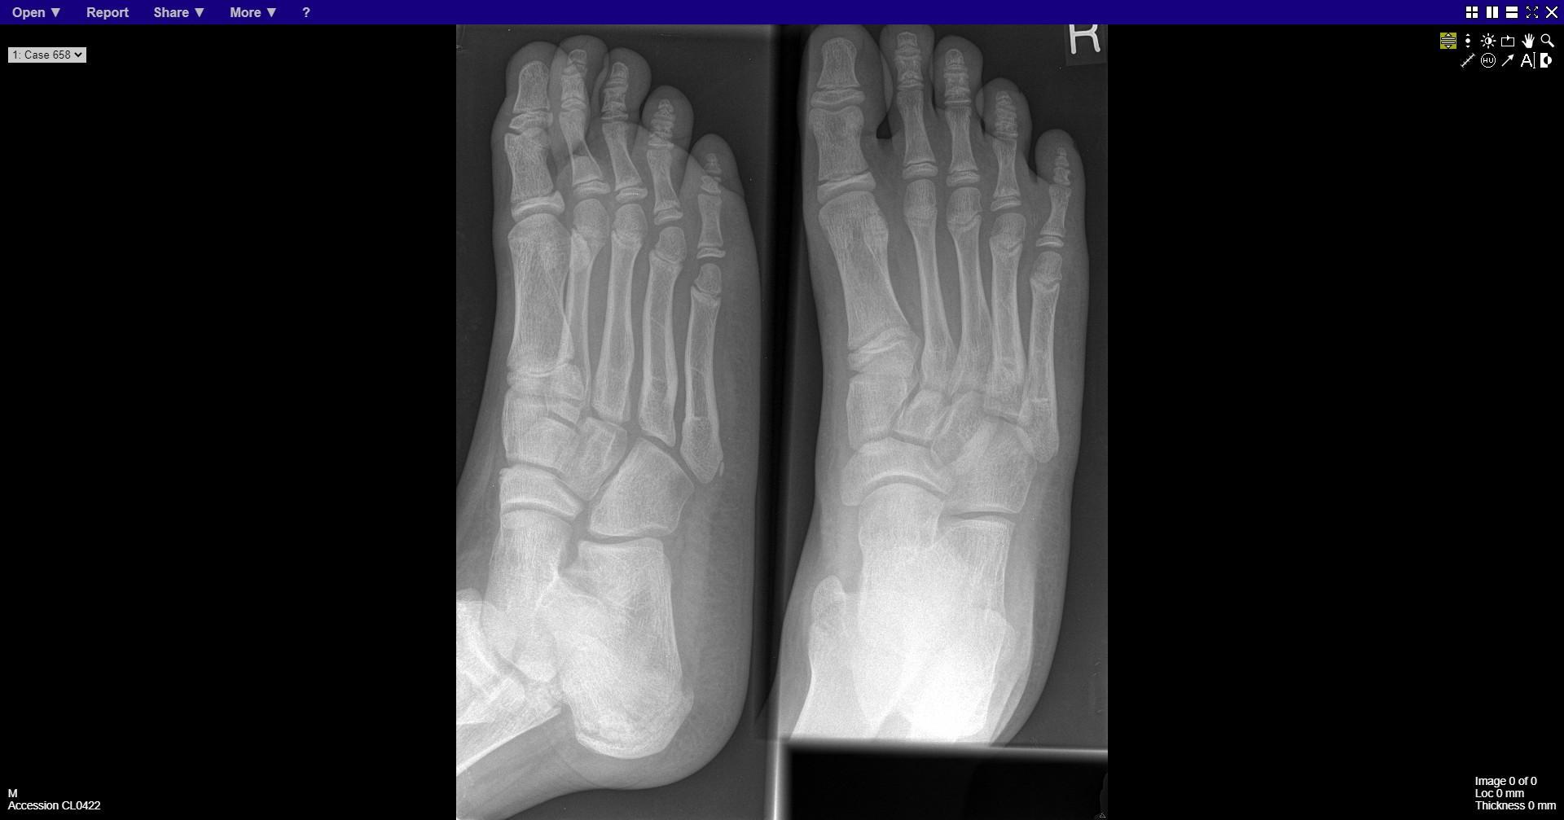
Notes:
normal

Slide 29
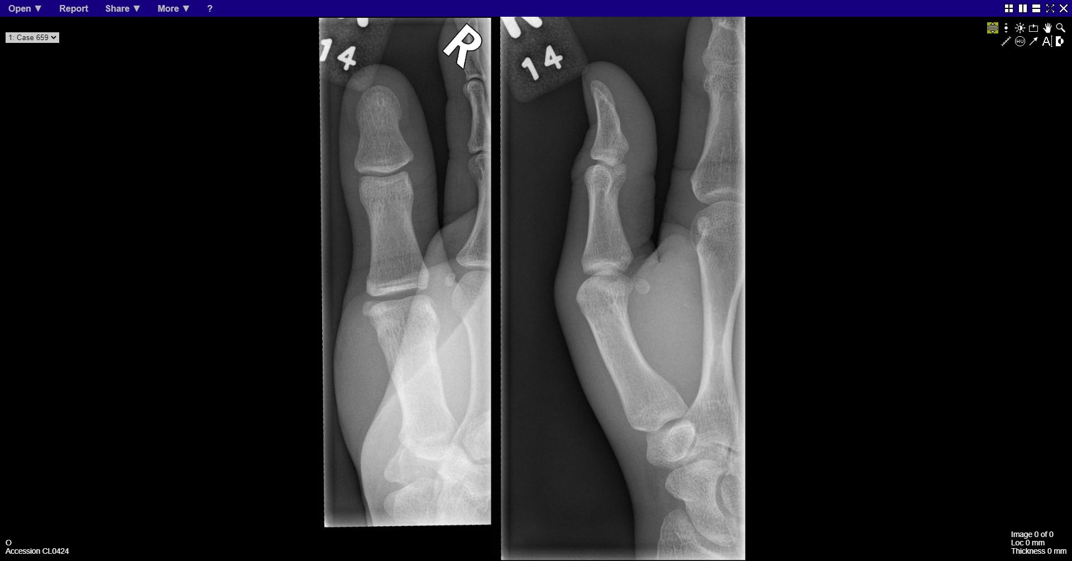

Slide 30
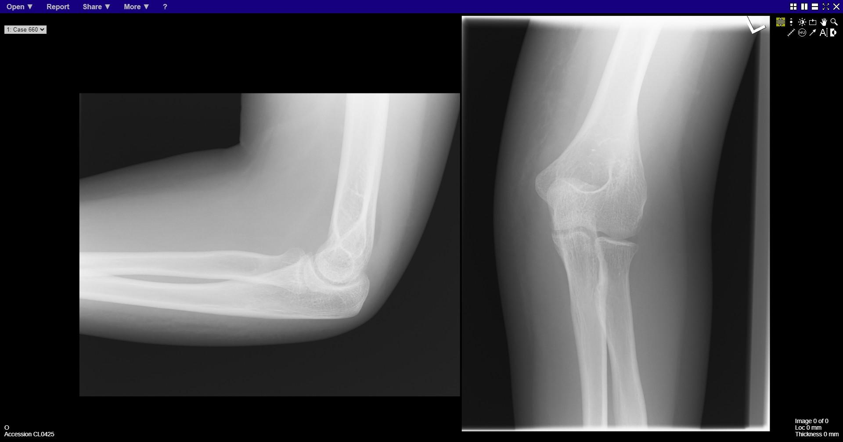
Notes:
Head of radius fracture
Elbow joint effusion

